Slide 1
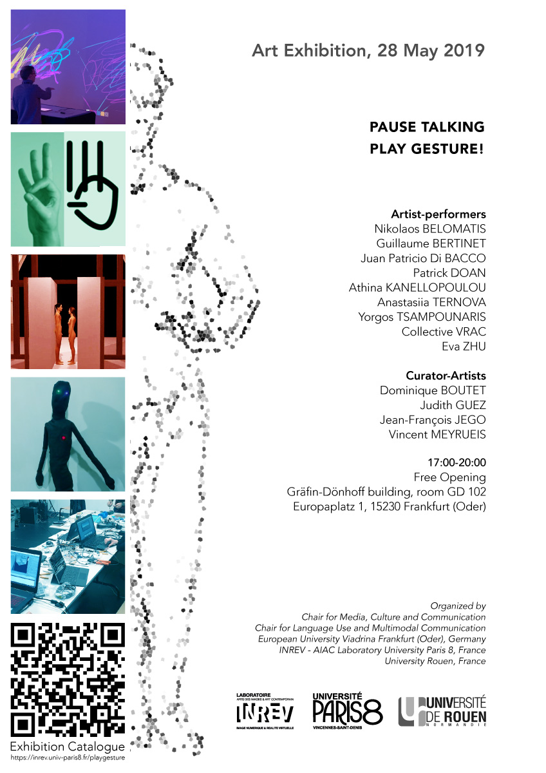
Pause Talking
Play Gesture
28 May 2019
Exhibition at ZeM
Frankfurt/Oder Germany

Slide 3
PAUSE TALKING
PLAY GESTURE!
We propose to interactively explore what is the characteristic of gesture with digital artworks inspired by Augmented Reality, Virtual Reality and Intelligent Objects.
Human gesture raises fascinating questions: How we perceive and understand the movement? How to make visible and tangible the expression, the behaviors? And what about the expressivity and the emotions in gesture?
In his book Mind’s Eye, Oliver Sacks explores the fundamental facets of human experience, how we represent the world internally when our eyes are closed, and the remarkable, unpredictable strategies that our brains find new ways of perceiving that create worlds as complete and rich as the no-longer-visible world.
Maurice Merleau-Ponty in the Eye & Mind examines how art, specifically painting, displays the act of viewing the world with openness and immersion that is more truly representative of the continuum of existence.
As humans, we use gesture to both to perceive and to act and real-time technologies now allow to reflect this aspect more and more.
The artworks presented in the exhibition Pause Talking, Play Gesture! are designed to experiment this reflection, participants are invited to experience, to exchange, to interact and to engage in their inner world of gestures.

Slide 5
ARTWORKS

Slide 6
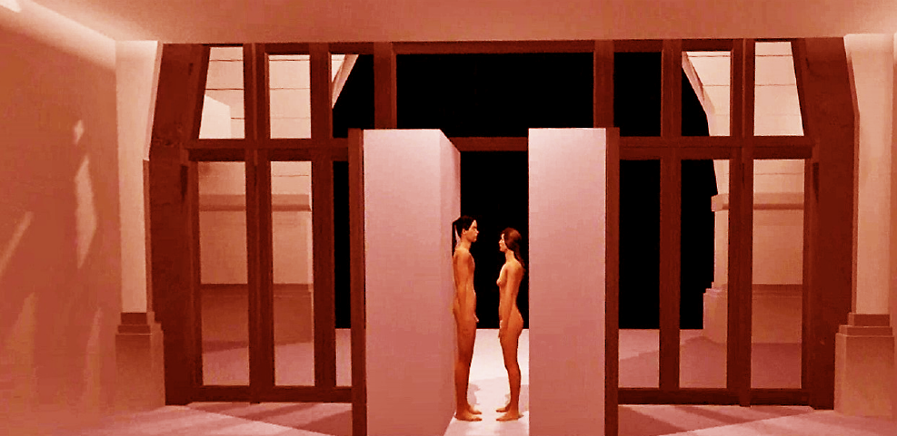
Artworks
IVAPA
Interactive Installation & Performance – 2019
KANELLOPOULOU Athina
BELOMATIS Nikolaos
Produced by
Arts & Technologies de l'Image Department University Paris 8, France
The International Virtual Archive of Performance Art (IVAPA) is an archive developed in a Virtual Reality environment. The purpose of this archive is to honor, to preserve, to showcase artworks and to help the audience to explore each performance and to live a relevant sensation as being in the accurate performance.
In IVAPA, visitors are immersing in the VR Environment of an extendable archive designed as a museum dedicated to performance art. It is an on-going project based on the concept of Representative Theory of Mind, Topoanalysis and Architecture's Data.
"On December 2016, during International Performance Art Week of Venice, I met Stelarc and Boris Nieslony. We had some conversations during those days. Nieslony, Stelarc and I discussed about documentation and preservation of this art discipline. Stelarc just teased us, asking if it is possible to gather every documentation, especially videos, in the biggest archive of Performance Art. Nowadays, the idea could be possible in a VR Environment” - Athina Kanellopoulou
The project is downloadable: https://athinakanellopoulo.wixsite.com/ivapa

Slide 7
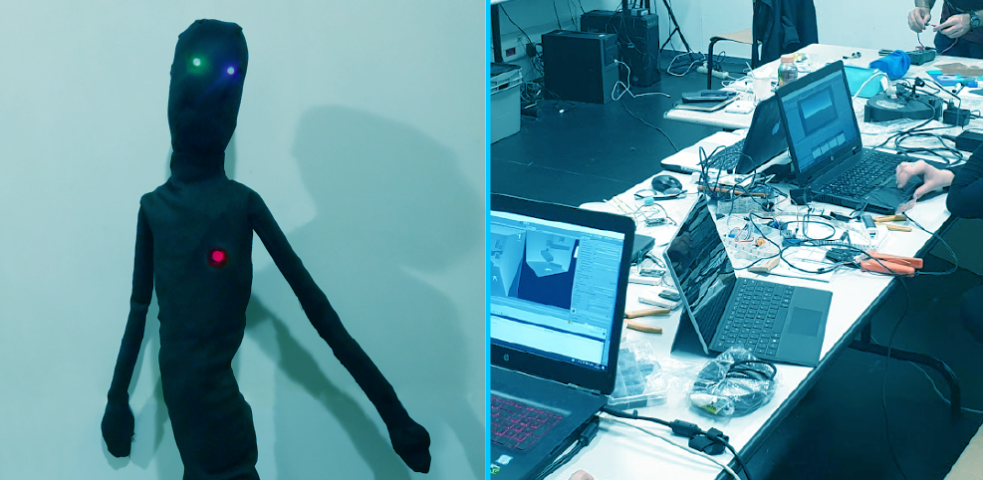
Artworks
LagaDoll
Interactive Installation – 2019
Juan Patricio Di BACCO
Athina KANELLOPOULOU
Anastasiia TERNOVA
Yorgos TSAMPOUNARIS
Eva ZHU
@nimat workshop-laboratory Supervised by
Vincent MEYRUEIS
Jean-François JEGO
Chu-Yin CHEN
Produced by
Idefi-CREATIC at the ATI Department University Paris 8, France
This artwork is the result of workshop-laboratory call “@nimat” proposed in the framework of the IDEFI CréaTIC which aims at supporting innovative educational projects. This workshop-laboratory was led by the Arts et Technologies de l’Image Department of the Paris 8 University and was aimed at exploring research-creation of gesture and embodiment. This year's theme was formulated as a question: "what a body can do?" and proposed to a group of students with heterogeneous skills from different master's courses.
Thus, an interactive experience was developed by the students to answer this question with a digital art creation. To do so, they connect real and virtual contents by the hybridization of internet of things IOT technologies, real-time 3D engine and the immersive device. They proposed an interactive experience based on a ragdoll puppet which allows the spectator to interact with their virtual counterpart. The ragdoll is equipped with a number of sensors and actuators which allow to question the empathic relationship between virtual and real through the manipulation of accessories that gives the illusion of life.

Slide 8
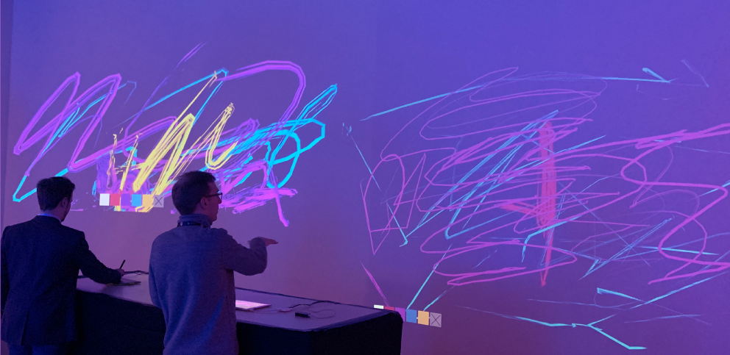
Artworks
Sceno- graffeur
Interactive Installation – 2018
Guillaume Bertinet
Judith Guez
Jean-François Jégo
Produced by
VRAC Collective, France
Digital painting tool, the Scenograffeur invites spectators to freely draw with light graph of the exhibition space. This virtual and real time painting tool has multiple use cases and propose to enhance performances with interactive visuals, in the hands of the VRAC collective, or of the spectators.
Spectators are allowed to participate in the exhibition’s scenography using a tablet allowing evolving graphic expressions, which leave room for creativity. The body version of the Scenograffeur is painting tool engaging the body. It allows to transpose and to increase the gestures of the spectator playing with traces and imprints that follow his movements.
These lightpaintings can be video projected on the environment or on the spectator’s own body using interactive videomapping.

Slide 9

Artworks
Typannot
Interactive Installation – 2017
Patrick DOAN
Dominique BOUTET
Produced by
Dylis laboratory University Rouen, France
Esad Amiens, Ministère de la culture Regions Hauts-de-France
The interactive installation allows people to imitate the handshapes of several signs in French Sign Language and to display these signs. By a simple imposition of hands, a kind of a gesture dictation instead of a speech dictation, a 3D hand tracking device tracks each digits. From these data, the system extracts phonological features and transforms them into a typeface dedicated to the transcription of Sign Languages. This didactic interface opens a window on the possibilities offered by the coupling between a typeface for gestures and a mocap device. Beyond a didactic installation to discover some signs, we can imagine, for instance, a dictionary whose entries could be morphological and fuzzy because coming from a learner of this language.
It is now possible to do what the body says in writing it to stop saying by a depiction what the body does.
This installation is made by the team GestualScript bringing together designers and linguists.

Slide 11
ARTISTS

Slide 12
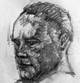
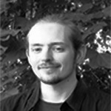
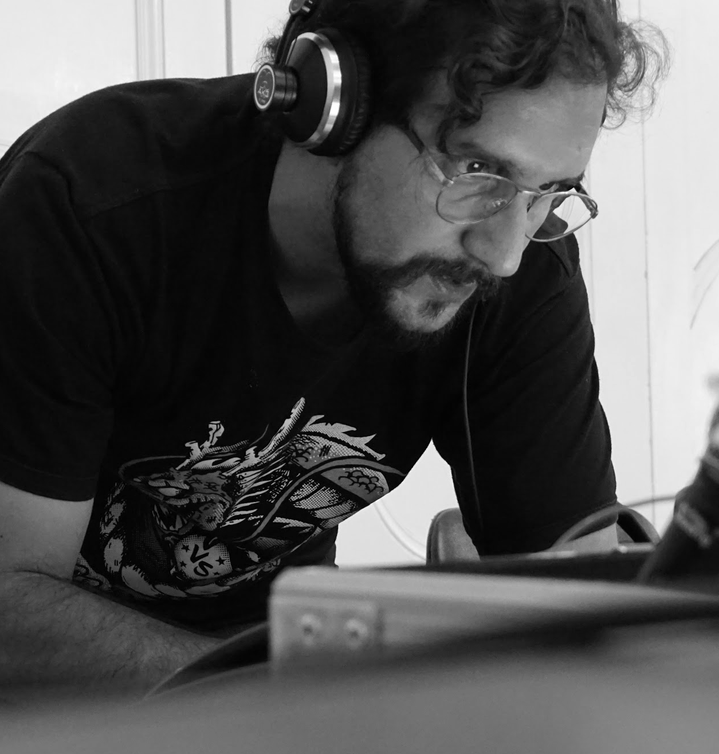
Artists-Performers
Nikolaos BELOMATIS
Nikolaos Belomatis (b. 1982, Athens) is an artist. He has studied Civil Engineering (TEI Athens) and he received a MA in Digital Arts (ASFA). He studies at Paris 8 university in order to obtain a MA in Art and Virtual Reality.
Guillaume BERTINET 3D graphic designer, expert in real-time image and VR compositing, Guillaume Bertinet main interest lies in exploring how to guide the visitor in the image through light and movement in VR experiences [La Chambre de K, Lab’Surd]. He is currently a lead artist at InnerspaceVR, and co-founder of the VRAC VR Art Collective. www.gustm.com
Juan Patricio Di BACCO
Juan Patricio Di Bacco, has been honing his skills in music and technology for the past several years. Originally a software developer, Patricio blended his music skills with his programming experience, bringing about a perfect marriage of his two passions.
Patricio’s evolution into programming allowed him to introduce another element to this union and extend the range of his work even further. The use of open hardware allows Patricio to challenge the boundaries of musical instruments and explore the depths of music and composition.

Slide 13
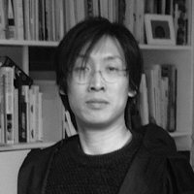
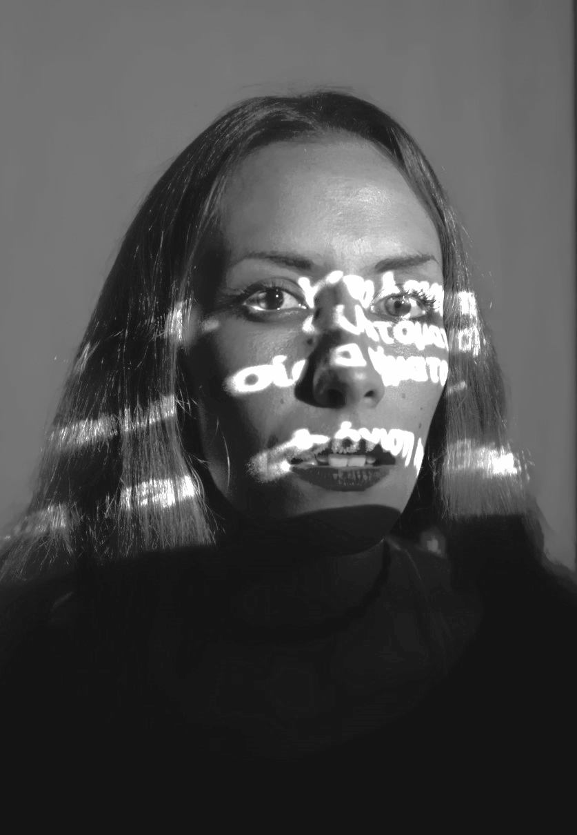
Artists-Performers
Patrick DOAN
Patrick Doan is a designer and educator in typography and type design. He teaches at École Supérieur d’Art et de Design of Amiens where he co-founded the post graduate program ESAD Type. With D. Boutet, he supervises the project TYPANNOT, a morphological transcription system for sign language. With the Technological University of Compiègne he worked on DESCRIPT, followed up by INSCRIPT, a research program aimed at developing an augmented environment to preserve and learn handwriting skills. He is currently completing his PhD on the subject of the attentional activity involved in writing.
Athina KANELLOPOULOU
Athina Kanellopoulou (b. 1985, Athens) is a multidisciplinary artist. She received a BSc Civil Engineering (ASPAITE), a BA Hons in Fine Arts (Middlesex University) and attends the MA Art & Technology of Virtual Image (University Paris 8- ASFA). Her artwork has been exhibited in Laval Virtual, Athens Biennale, Venice Culture Center, Copenhagen Art Institute and Museums Benaki, KMMN, Zapadores, Zimmerli, AnimaSyros, etc. www.athinakanellopoulou.com
Anastasiia TERNOVA
Student of the Paris 8 University (branch: Theatre. History and creation, master degree), originally from Ukraine. Domains of research: use of modern technologies in theatre (particularly lifetime motion capture), performance creation, acting, writing, fairy tales, translation.

Slide 14

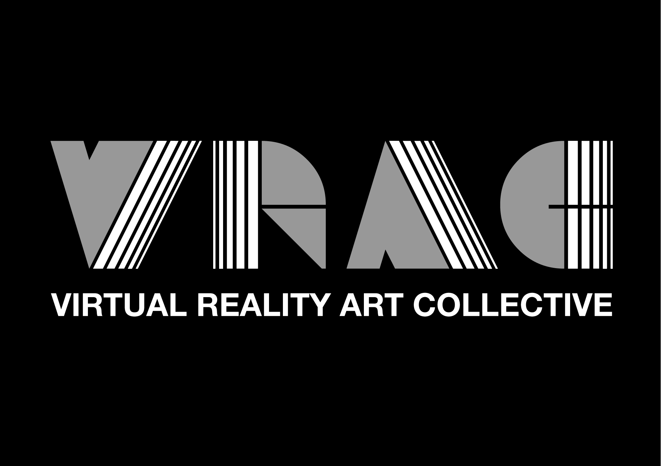
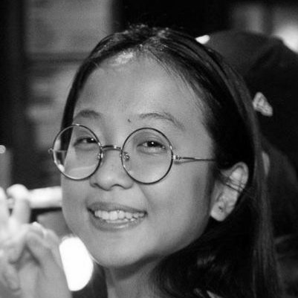
Artists-Performers
Yorgos TSAMPOUNARIS
Yorgos Tsampounaris is a programmer/artist in the fields of motion capture, virtual/mixed reality and game development. He is a master student at the French-Hellenic master in Arts et Technologies at University Paris 8 and Athens Fine Arts. He holds a Bachelor’s degree in Computer science at University of Athens. In the past, he has been occupied as a researcher in ATHENA Research Center in the Wholodance project and as a digital compositor in Yafka Visual Effects Studio in the cinematic Industry.
Collective VRAC The VRAC —Virtual Reality Art Collective— is a group of VR creative practitioners. The VRAC manifesto proposes to create Artworks using Virtual Reality designing sensitive and participative interactions referring to two art movements: the Surrealism and the GRAV (the Research Group in Visual Art). Artworks from the VRAC aspire to elicit a singular experience in the visitor, emerging from his actions and questioning his own reality. As part as our creation process, the collective develop various ways to engage a large audience in a participatory stance: workshops, performances, exhibitions, conferences and seminars. www.vracollective.com
Eva ZHU Eva Zhu is an art student from Spain (Facultad de Bellas Artes UCM, Madrid) but currently staying in Paris (Paris 8). Starting as a Fine Arts student, she practised painting, drawing and sculpture. After doing research in the reality of art she dropped these activities out and now she is centered in actions, performance, human being relations and meta-reference the center of her work.

Slide 15
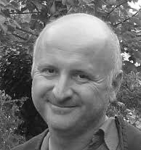
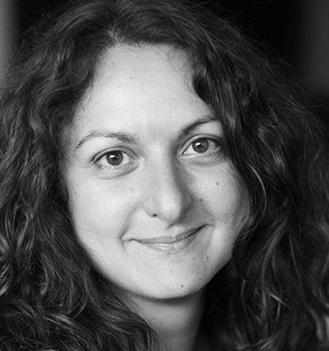
Artists-Curators
Dominique BOUTET Associate professor in University of Rouen (France), as linguist and semiotician, he is interested in gestural phenomena and specifically in multimodality, Sign Languages, artistic expression and history of the representation. His work is mainly focused on the relations between Sign Languages and gestures. He explores the whole body as a medium of the co-construction of forms — symbolic and object-like. The human environment is mainly considered as a production or an externalization of the body, henceforth, its gestural representation builds through a bodily iconicity some visual consequences. The semiotics of the graphical representation of the body through the history of art, made by the images and the absence of the movement, runs counter to the semiotics of the gesture. He explores this situation between the images and the gestures.
Judith GUEZ Dr. Judith Guez is an artist – researcher – engineer in VR/MR. Her research focuses on understanding and creating illusions between the real and the virtual to explore new artistic forms, mobilizing the concept of presence and wonder. She has exhibited many artworks (La chambre de Kristoffer, Lab’Surd, InterACTE, Liber, Rock Art Rocks me…) in several international venues (Ars Electronica in Austria, Gaîté Lyrique, GoogleLab, BPI Centre Pompidou, Centre des arts Enghien, MOCA Taipei in Taiwan, VR World Forum in Switzerland). She is currently founder and director of the artistic pole at Laval Virtual. In this context, she has created in 2018 the international Art&VR festival Recto VRso at Laval Virtual (7 exhibitions in Laval with 38 artworks from 67 international artists). She is co-founder of the VRAC (VR Art Collective). http://judartvr.wordpress.com

Slide 16
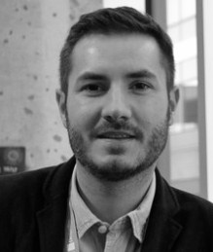
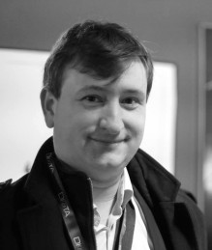
Artists-Curators
Jean-François JEGO Jean-François Jégo is associate professor at the Arts & Technologies de l’Image department of the Faculty of Arts at the Université Paris 8 in France. He is also digital artist and researcher at the INREV Virtual Reality Laboratory where he creates immersive and interactive experiences, art installations and digital performances hybridizing Virtual Reality and Augmented Reality. His research topics question human perception and the aesthetics of interaction, exploring embodied cognition and interaction, focusing on the expressivity of human and virtual gestures in digital art. His installations and performances have been exhibited in many national and international venues (IRCAM Centre Pompidou in France, MOCA in Taiwan, Ars Electronica in Austria...). As a curator, in 2016 Jean-François presented the artworks of forty artists at the third international symposium on Movement and Computing in Greece. He also co-organized the Ars Electronica Campus Exhibition 2015 in Austria presenting thirty years of digital research and creative works of seventy artists to more than 2500 visitors. He is cofounder of the international Think-Tank GAIIA Gesture & Artificial Intelligence in Industry & Arts (www.gaiia.online) and of the artistic collective VRAC (www.vracollective.com). Personal website: www.jfcad.com
Vincent MEYRUEIS Vincent Meyrueis is associate professor at Paris 8 University and co-head of the Arts & Images Technologies Department of the Faculty of Arts Philosophy and Aesthetics. As a researcher, he is a member of the research team in Digital Image and Virtual Reality (INREV) of the laboratory AI-AC EA4010 of Paris 8 University.After studying engineering in design science, his research initially focused on interaction prototyping and the use of immersive tools in the upstream design phases of interactive and connected products. Since then, his research interests focus interaction design and the new way of immersive and interactive content writings from a theoretical, technical and aesthetic point of view. He has also contributed to the setting up of innovative educational workshops within the framework of the IDEFI CréaTIC associating research and creation on issues of articulation between real and virtual with robotics. He is also a member of the Academic Council of EUR ArTeC, member of the Board of the French Association of Virtual, augmented and mixed Reality (AFRV) as well as member of the research and development college of the association Uni-XR; he took part in the bringing together of these two associations. Finally, he is co-founder of the International Think-Tank GAIIA Gesture & Artificial Intelligence in Industry & Arts (www.gaiia.online).

Slide 18

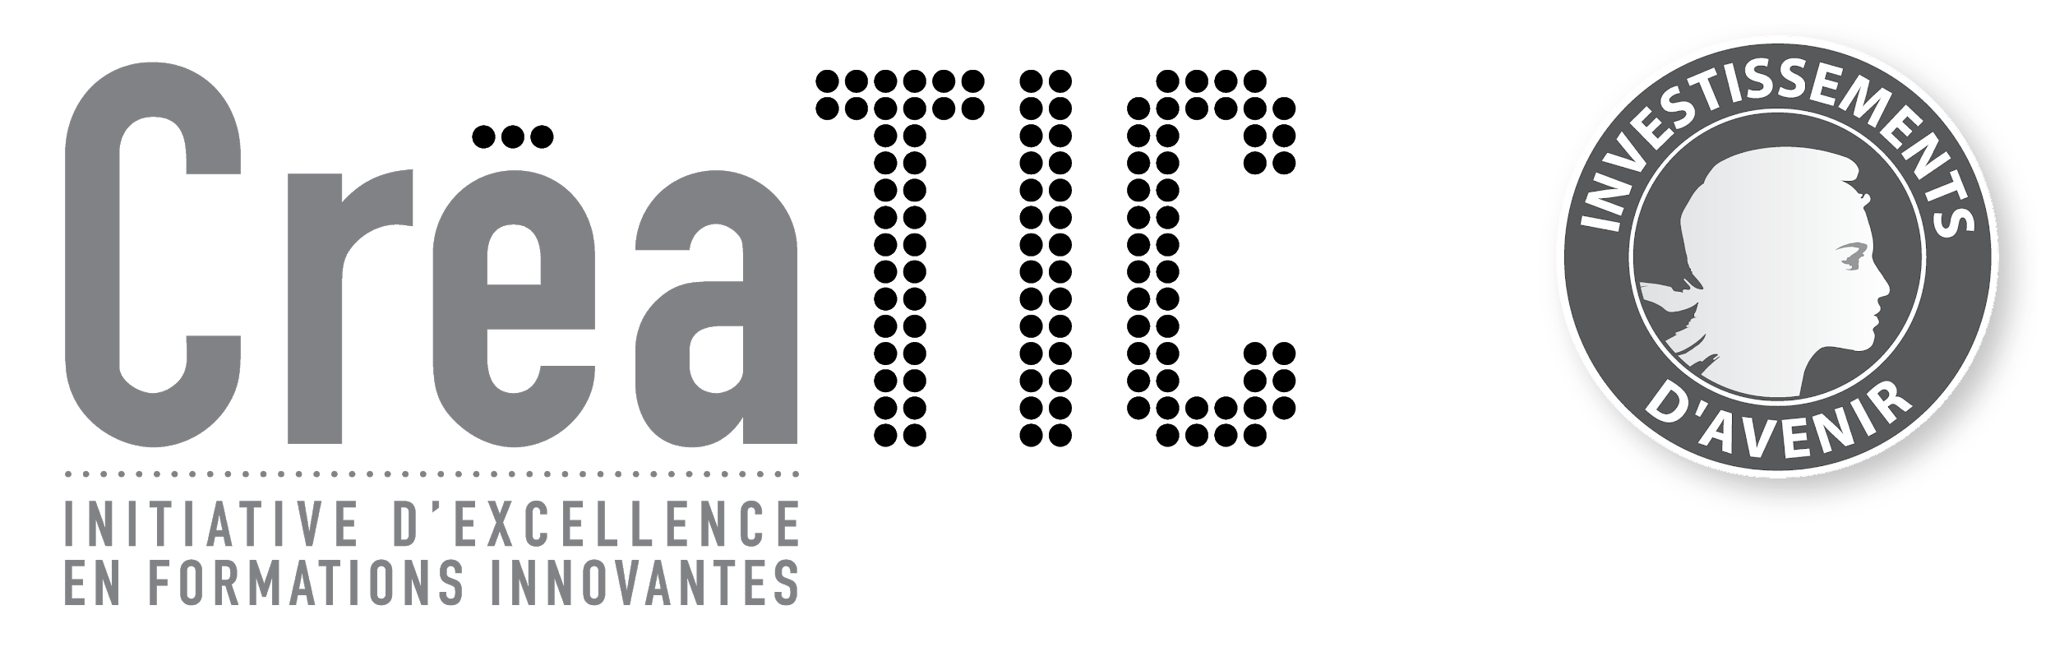
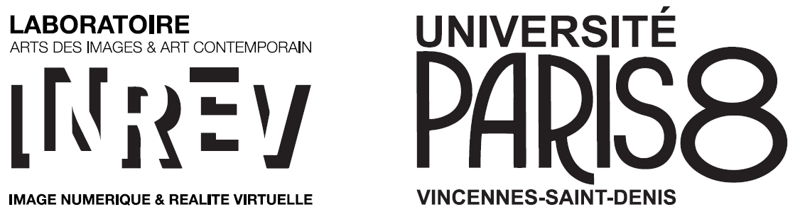




PAUSE TALKING
PLAY GESTURE!
Chair for Media, Culture and Communication Chair for Language Use and Multimodal Communication European University Viadrina Frankfurt (Oder), Germany
Idefi-CREATIC Program INREV - AIAC Laboratory University Paris 8, France
University Rouen, France
Laval Virtual, France
VRAC Collective, France
Acknowledgment
Sarah GREIFENSTEIN Dorothea HORST Lena HOTZE Jana JUNGE Clara KINDLER Cornelia MULLER
Illustration
Mathias ROLOFF
Catalogue layout
Jean-François JEGO
© INREV - May 2019

